Slide 1

Sushi Samurai
Coding by: Christian Mejia & Paul Caldwell
Graphics by: Jerrod Tanner & Jordan Sterling

Slide 2
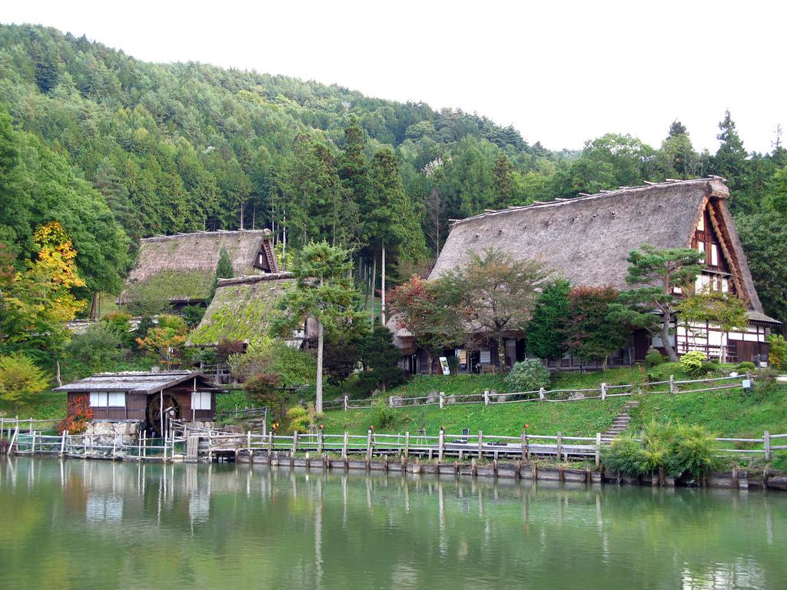
Village in Need
In a dog-eat-dog world, our Samurai protagonist finds himself back in his hometown after a decade of traveling and training. There seems to be a problem. The Village is running out of food, and needs their beloved Samurai to provide help in this time of need.

Slide 3



Sharks Sharks Sharks
In this action-packed, shark slaying game, there are man-eating hungry sharks, which hold the food to feed your village.

Slide 4
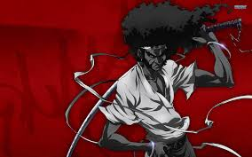
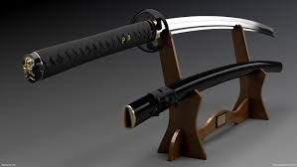
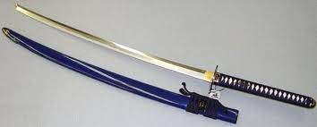
Samurai
Be the Samurai you have always wanted to be and cut up some sharks to provide food for your village.

Slide 5

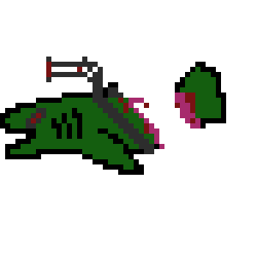

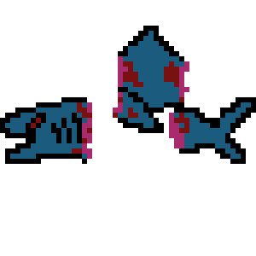
Sushi Sushi Sushi

